Slide 1
Demystifying Microsoft Fabric: Architecture and Organization 101
Data Saturday Chicago
March 14th, 2026

Slide 2
Demystifying Microsoft Fabric
Architecture and Organization 101
As with any other new technology, Microsoft Fabric comes with a host of new terms and concepts. Do you know your tenants from your capacities from your workspaces? How about your data lakes from your delta lakes and your lakehouses from your warehouses? If not, you're not alone!
This session is aimed at data analysts, on-premises data professionals, managers/executives, and other tech pros struggling to understand the purpose, architecture, and organization of Fabric. We'll use plain English and not marketing-speak or technobabble to ensure all attendees have a shared understanding of this new paradigm for analytics in the Microsoft ecosystem.

Slide 3


He / him pronouns
Microsoft Data Platform MVP
MCSE: Data Management and Analytics
Albuquerque data platform group leader
Contact me:
Bluesky: @chrishyde325.bsky.social
Email: chrishyde325@gmail.com
Chris Hyde
Owner and Principal Consultant
Hydrate Consulting, LLC
@chrishyde325.bsky.social

Slide 4
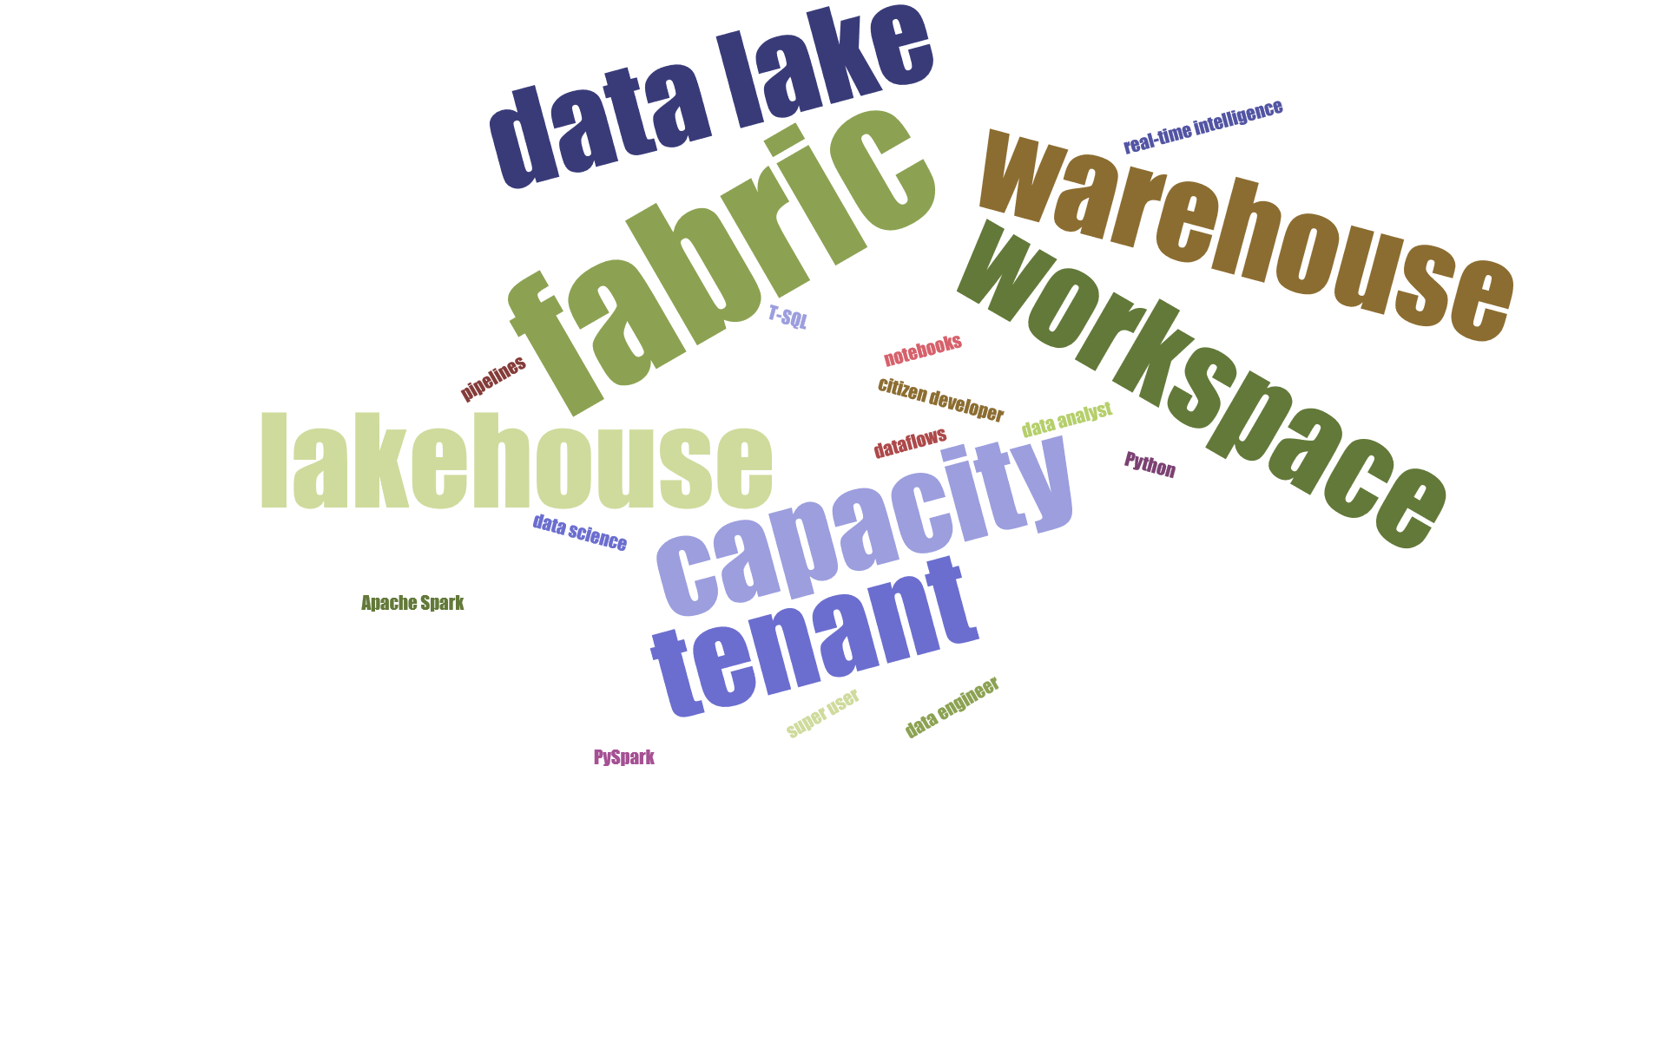

Slide 5
agenda
“100 level” overview of Microsoft Fabric
Data Lake / Delta Lake / Lakehouse / Warehouse
Tenant → Capacity → Workspace
Medallion architecture
High-Level security
Example case studies

Slide 6
what is Microsoft Fabric?
Microsoft’s next generation all-in-one data analytics product
Full integration of data warehousing, data engineering, and data science tools into the same portal as Power BI (reporting and data visualization)
Software-as-a-Service (SaaS) rather than Platform-as-a-Service (PaaS)
One copy of data in the integrated OneLake data lake

Slide 7
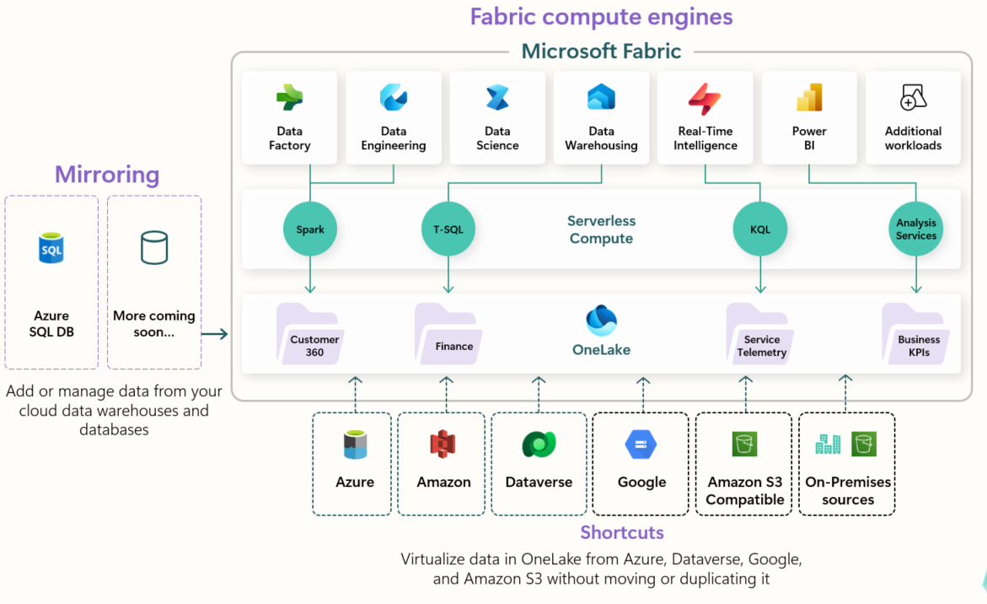
Fabric architecture

Slide 8
what is a data warehouse?
Microsoft’s Webster's Dictionary defines a data warehouse as...​
Central repository of current and historical data​; usually from multiple sources​
Data is combined and reshaped to support analytical workloads​
Typically business-focused rather than IT-focused​

Slide 9
what is a data lake?
Centralized storage repository for data in it's native format​
Structured data, ie. tables, .csv files​ and semi-structured data, ie. JSON, XML​
Unstructured data, ie. images, sound files, video files​
Organized in a folder structure like a file share​
Can become a data swamp if you're not careful!

Slide 10
what is a lakehouse?
“…An open architecture that combines the best elements of data lakes and data warehouses.”
Both structured and unstructured data
Transaction (ACID) support; Schema enforcement and governance
Open standards; Storage is de-coupled from Compute

Slide 11
bonus: what is a delta lake?
A lakehouse where the tables are in delta parquet format
Parquet is a columnar storage format
Delta is the layer on top of parquet that provides transactions, ACID compliance, and scalable metadata
A Fabric lakehouse is by definition a delta lake

Slide 12
building blocks of Fabric
Tenant – organization-level Entra tenant
Capacity – a distinct resource pool for Fabric; a tenant can have multiple capacities
Workspace – a container for Fabric items within a capacity; a capacity will have multiple workspaces
My workspace - each user has a personal workspace
( https://learn.microsoft.com/en-us/fabric/enterprise/licenses )

Slide 13
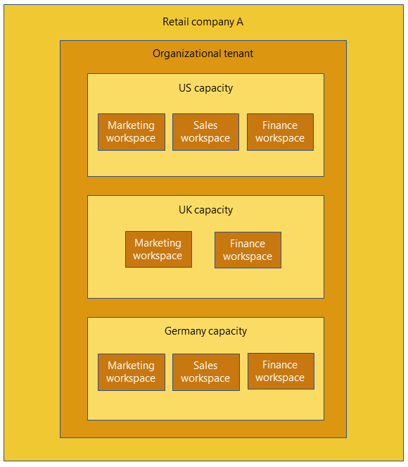

organizing Fabric, part 1

Slide 14
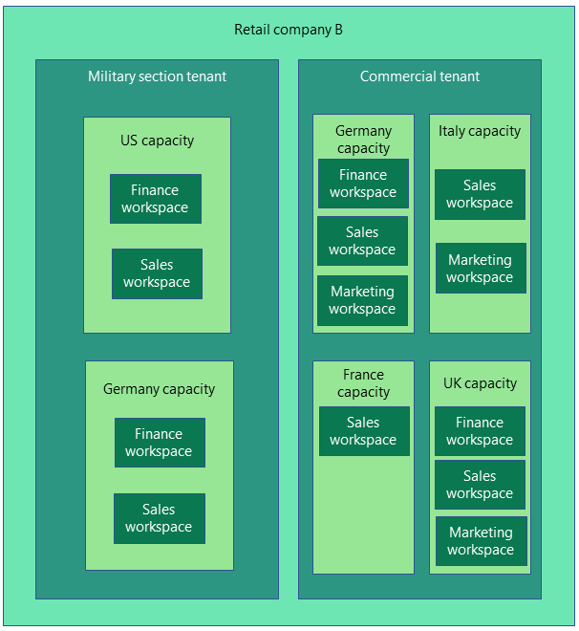
organizing Fabric, part 2

Slide 15
Fabric architecture, the reprise

Slide 16
medallion architecture
A data design pattern used to logically organize data in a lakehouse, or broadly, any analytics system​
Originally popularized by Databricks in 2020, now common across other platforms​
Canonically three layers: Bronze → Silver → Gold​
Each layer has a specific purpose and quality level​
Not Fabric-specific, but maps well to Lakehouse patterns​

Slide 17
bronze layer
Raw data​ from business systems
No transformations, no cleaning​
Preserves original schema, shape, and values (but consider adding ingestion timestamps)​
Your fallback layer if later transformations go wrong​
Provides traceability and replayability​
-

Slide 18
silver layer
Enriched data​
Cleansed, conformed, de-duplicated, validated, ​
Usually relationally-modeled tables​
Mapping between different sources happens here​
In Fabric this could be delta tables in a lakehouse or T-SQL tables in a warehouse​
-

Slide 19
gold layer
Curated data​
Business-focused, query-optimized presentation layer​
Hopefully data-governed and certified!​
Usually a dimensionally-modeled star schema​
In Fabric this could be a lakehouse or warehouse, and is the data source for your Power BI semantic

Slide 20
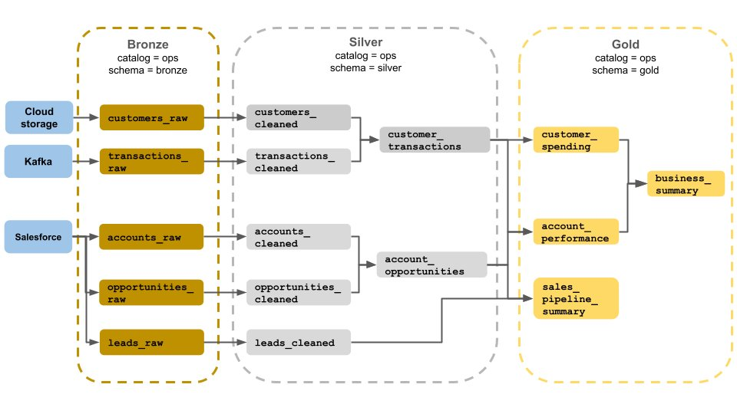
medallion architecture example

Slide 21
high-level Fabric security
Workspace-level security
Reader – can view all
Contributor – can view and modify all
Member – can view, modify, and share all
Admin - can view, modify, share, and manage all
( https://learn.microsoft.com/en-us/fabric/security/permission-model )

Slide 22
case study #1
Community college on legacy on-prem systems moving to 100% cloud-based architecture
Centralized Office of Data Strategy plus department-specific analysts
Shared roles; jacks- and jills-of-all-trades
Academic (student), HR, and Finance data must have appropriate access

Slide 23
case study #1
Single capacity
Three workspaces, one each for academic, HR, and finance data for proof-of-concept
Bronze and silver lakehouses for each individual source system, one gold warehouse in each subject area
Three additional workspaces for development in each subject area are planned, leveraging shortcuts so as not to double-ingest data

Slide 24
case study #2
Large financial enterprise with more modern hybrid analytical architecture
Specialized data engineers, data modelers, data analysts, and report-writers
Several existing data marts for specific departments and subject areas

Slide 25
case study #2
Separate capacities for prod and dev environments
Separate workspaces for each source system
Also separate workspaces for semantic models and reports

Slide 26
Resources
https://github.com/DrJekyll325/Presentations
azure.microsoft.com/en-us/blog/introducing-microsoft-fabric-data-analytics-for-the-era-of-ai/
https://learn.microsoft.com/en-us/training/fabric/
aka.ms/FabricRoadmap

